Slide 1


A
Project Presentation On
SPAM EMAIL DETECTION
Guru Ghasidas Vishwavidyalaya, Koni
Bilaspur, Chhattisgarh
May-2025
PRESENTED BY :
Vijaya L. Singh
B.Sc (Hons) CSIT
VI Sem
GUIDED BY :
Mr.Vivek Sarathe
Asst. Professor
Dept. of CS & IT

Slide 2
INTRODUCTION
In today’s digital world, spam emails are a growing concern, affecting both individuals and organizations. They range from annoying advertisements to serious threats like phishing and malware.This project focuses on developing a machine learning-based system to detect and classify spam messages using the Naive Bayes algorithm. By training the model on real-world data and integrating it with an interactive web interface using Streamlit, we can efficiently identify and filter spam messages. This enhances email security and improves user productivity.

Slide 3
REQUIREMENTS & SPEIFICATIONS
Software Requirements:
1. Programming Environment
Python 3.7 or higher
2. Python Libraries
pandas – for data manipulation
scikit-learn – for machine learning (train-test split, CountVectorizer, Naive Bayes)
streamlit – to create the web interface
streamlit-lottie – to display Lottie animations
requests – for fetching animation files from the web
3. Dataset
spam.csv – labeled dataset containing email/text messages classified as "spam" or "ham"
4. Web Interface
Streamlit-compatible browser (e.g., Chrome, Firefox)
Internet connection (for Lottie animation loading)
5. Operating System
Works on Windows, macOS, or Linux

Slide 4
Hardware Requirements:
Minimun Requirement:
Processor: Dual-Core 2.0 GHz or higher
RAM: 4 GB
Storage: 500 MB of free disk space
Display: 1024x768 resolution
Internet: Required (for loading Lottie animations)

Slide 5
OBJECTIVE
The main objective of this project is to develop a machine learning-based application that can accurately classify email or text messages as Spam or Not Spam.Using the Naive Bayes algorithm and natural language processing (NLP) techniques, the system aims to:
Detect spam messages with high accuracy.
Minimize false positives and negatives.
Provide a simple and interactive Streamlit-based web interface for real-time testing.
Enhance user safety and productivity by filtering unwanted messages.

Slide 6
DATA FLOW – Spam Email Detection
1. Input
User provides a message through the Streamlit web interface.
Alternatively, labeled data (spam.csv) is used for training.
2. Data Preprocessing
Remove duplicate messages.
Label categories as “Spam” or “Not Spam”.
Split the dataset into training and testing sets.
3. Feature Extraction
Use CountVectorizer to convert messages into numerical features (bag-of-words model).
Apply stop word removal for better accuracy.
4. Model Training
Train a Multinomial Naive Bayes classifier using the processed features and labels.
5. Prediction
Convert user input into the same feature format.
Predict using the trained Naive Bayes model.
6. Output
Display prediction result (Spam or Not Spam).
Visual feedback provided via Lottie animations.

Slide 7
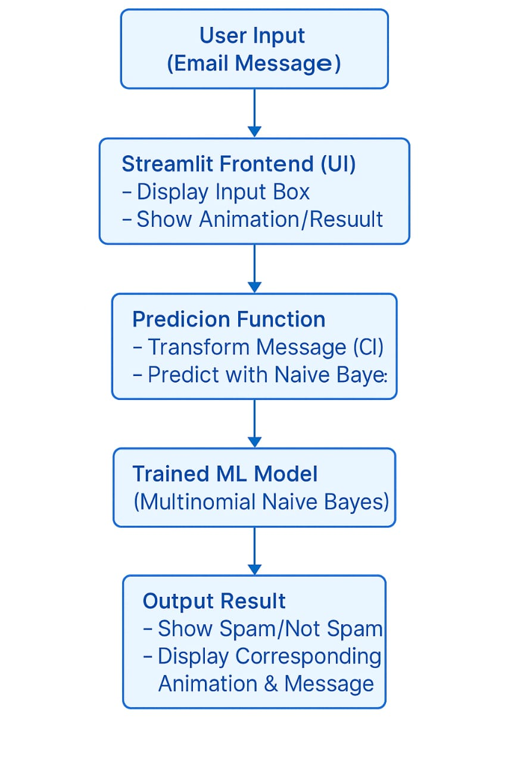
Data Flow Diagram:- Level 0

Slide 8
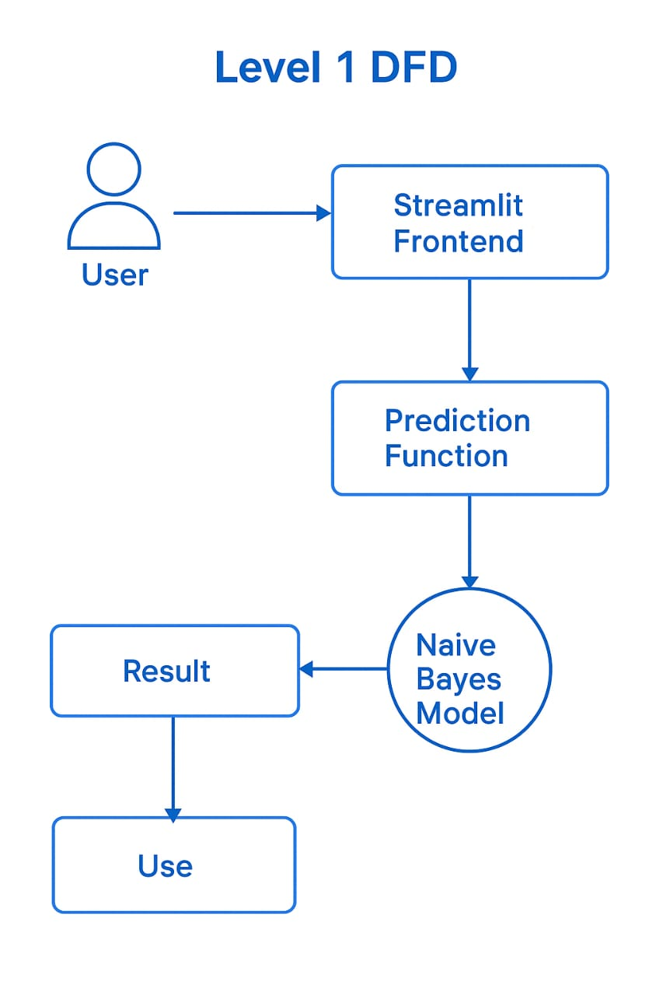
Data Flow Diagram:- Level 1

Slide 9
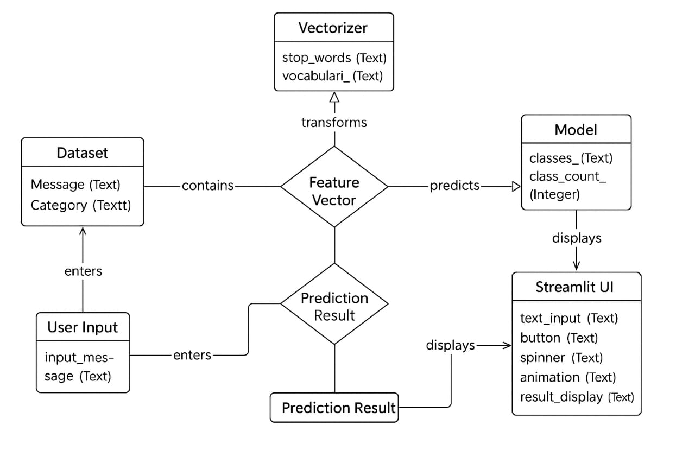
ER Diagram:-

Slide 10
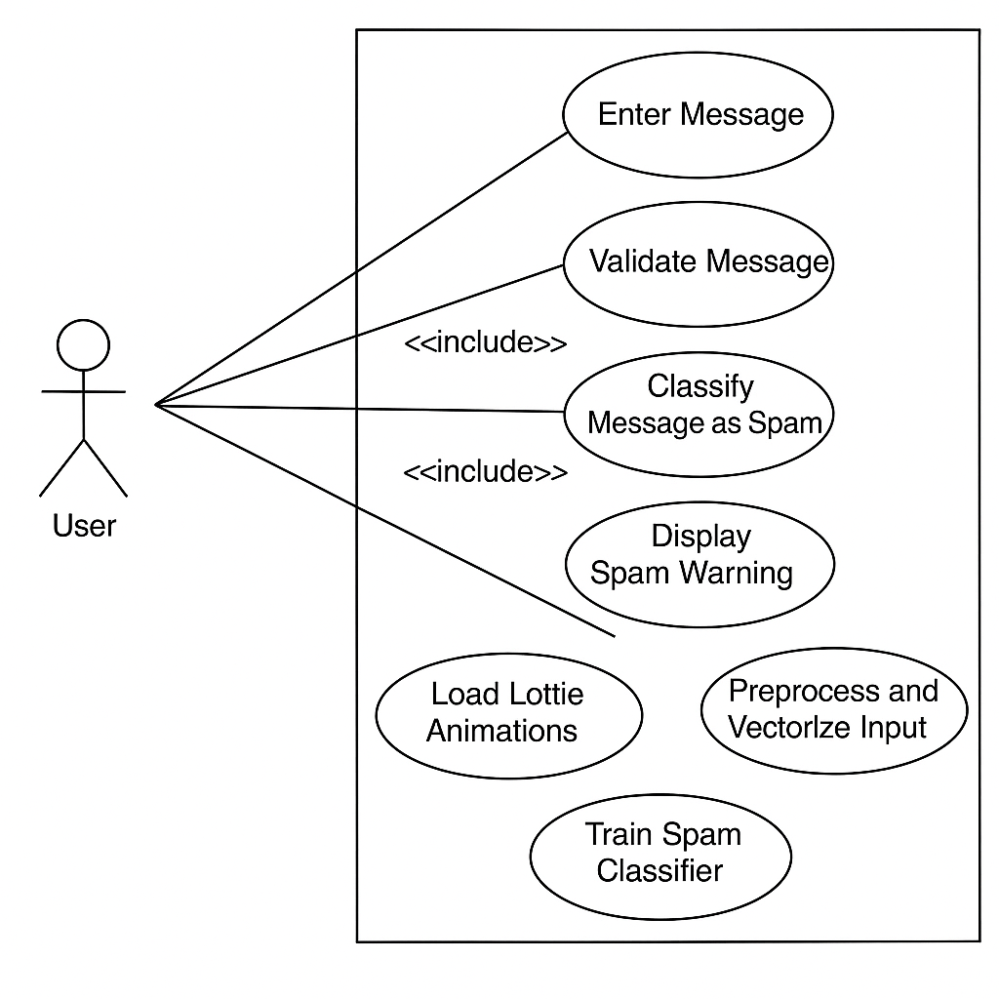
Use Case Diagram:-

Slide 11
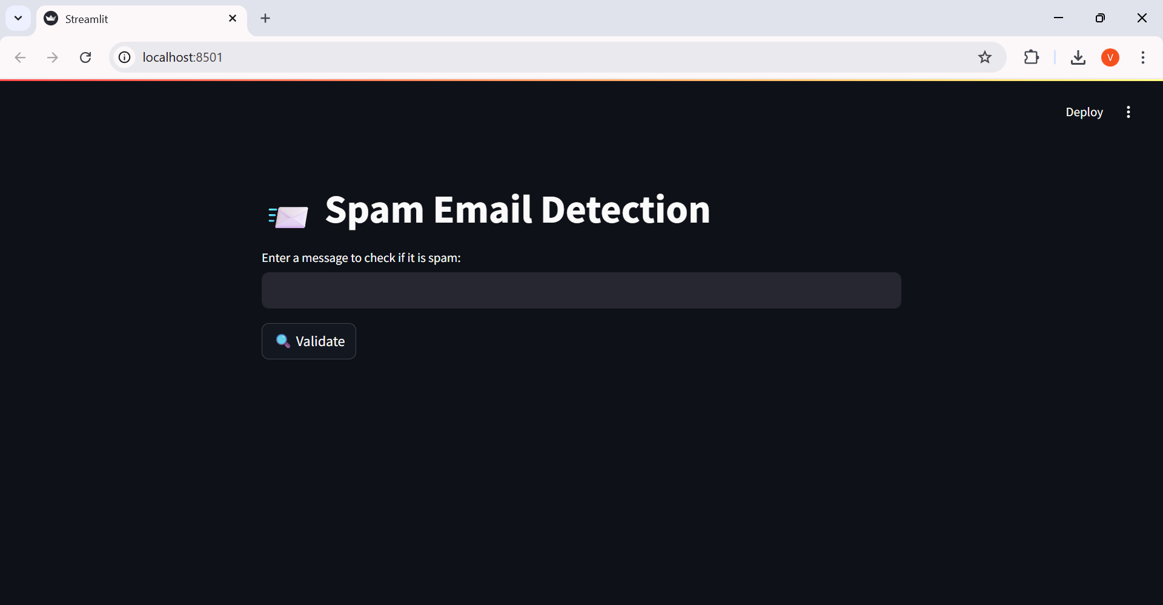
Homepage:-

Slide 12
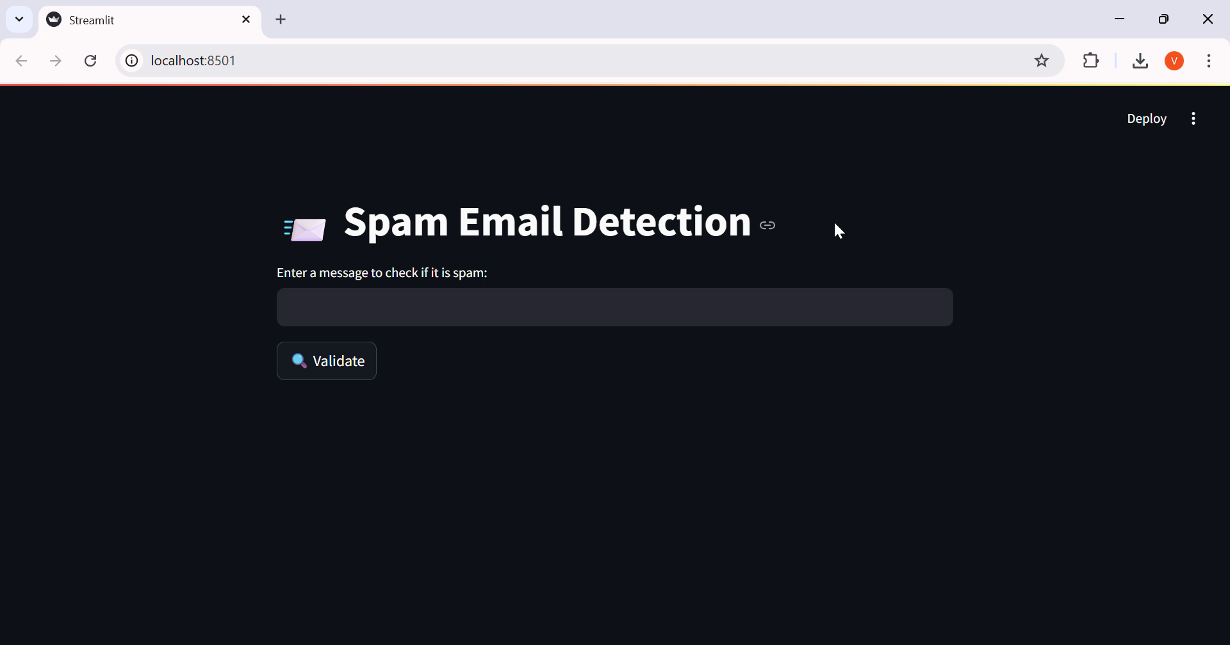
Sample Page 1:-

Slide 13
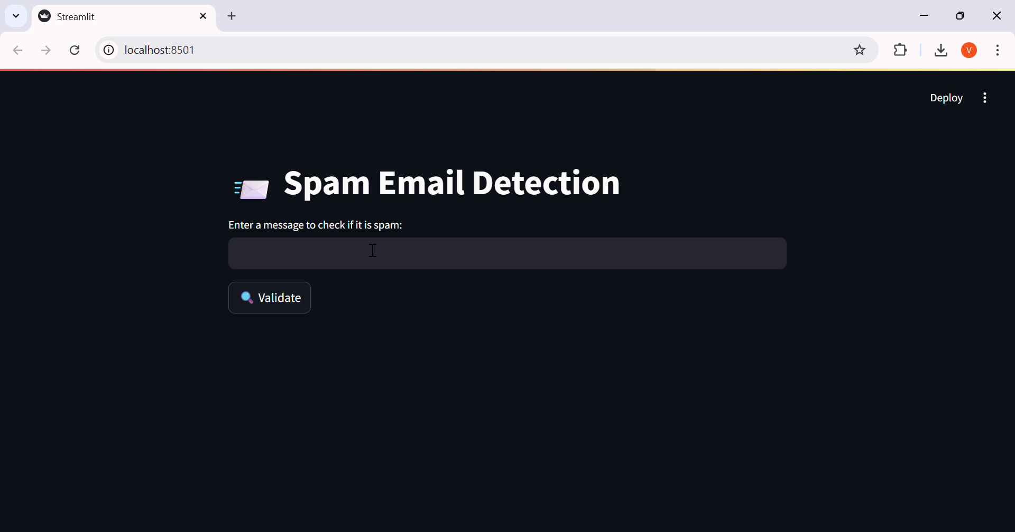
Sample page 2:-

Slide 14
Advantages:-
✅ Real-World Impact
Detects spam in SMS/email – practical cybersecurity use
⚙️ Efficient & Fast
Naive Bayes algorithm with CountVectorizer
Fast, accurate message classification
💻 User-Friendly Interface
Built with Streamlit – simple, interactive design
Real-time predictions from user input
🎨 Visual & Engaging
Lottie animations for spam, safe, and loading feedback
Improves user experience
🧩 Modular & Extensible
Clean codebase – easy to expand or modify

Slide 15
Conclusion:-
This project successfully demonstrates how machine learning can be applied to real-world problems like spam detection. By leveraging the Naive Bayes algorithm and a user-friendly Streamlit interface, it offers fast, accurate predictions with an engaging user experience. The modular design and visual elements make it both functional and accessible, laying a strong foundation for future improvements such as larger datasets, additional algorithms, or email integration.

Slide 16

“The success of this project is shared with all who offered their guidance and support.”
THANK YOU !

